Slide 1

Visual Exploration of Spatial-Temporal Dynamics of Air Quality using Volunteered Geographic Information: A Study Case of PM 2.5 in Minneapolis, United States
Dr. Ying Song, Zain Ul Abdin Siyal
Department of Geography, Environment & Society
University of Minnesota, Twin Cities
June 3-6, 2024

Slide 2
INTRODUCTION
Understanding air quality dynamics in Minneapolis as part of the broader goal of Climate Smart GIScience.
Air pollution in urban areas, particularly PM 2.5, poses significant environmental and public health challenges.
Various factors shaping PM2.5 levels were explored.
The study utilizes volunteered geographic information (VGI) and open data portals to conduct a spatial-temporal analysis of air quality dynamics.

Slide 3
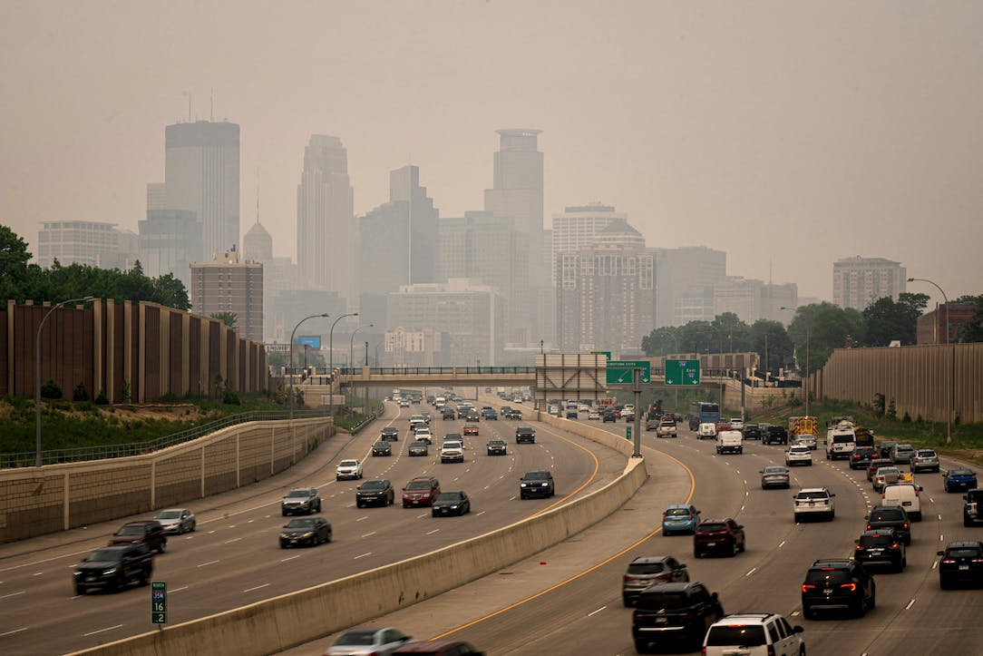
PROBLEM STATEMENT
The challenge of air pollution in the Minneapolis metropolitan area
Despite growing access to air quality data, understanding the impact of anthropogenic activities, economic development, and meteorological conditions affect PM2.5 levels remains limited.
Research gap regarding the impact of abnormal weather events on PM2.5
Source: StarTribune
Notes:
Despite advancements in understanding PM2.5 dynamics, there remains a gap in research concerning the specific impacts of extreme weather events on particulate matter dynamics.
This study seeks to address this gap by investigating the influence of weather patterns, such as heavy rain, snowfall, and heatwaves, on PM2.5 concentrations, aiming to enhance our understanding of the interaction between weather events and air quality.

Slide 4
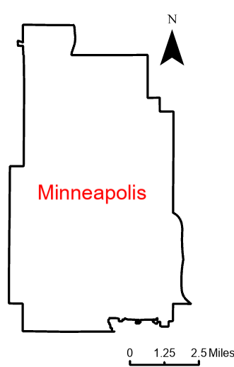
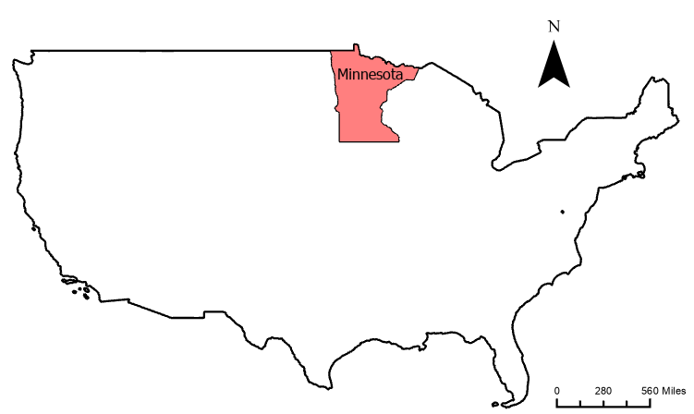
STUDY AREA AND DATA
Location: Minneapolis, U.S.
Data Source: Purple Air
More than 100 sensors and hourly average reading
Description of the dataset: PM2.5 data for April, July, October, December 2023 and special cases
Importance of volunteered geographic information (VGI) for real-time and historical air quality monitoring

Slide 5
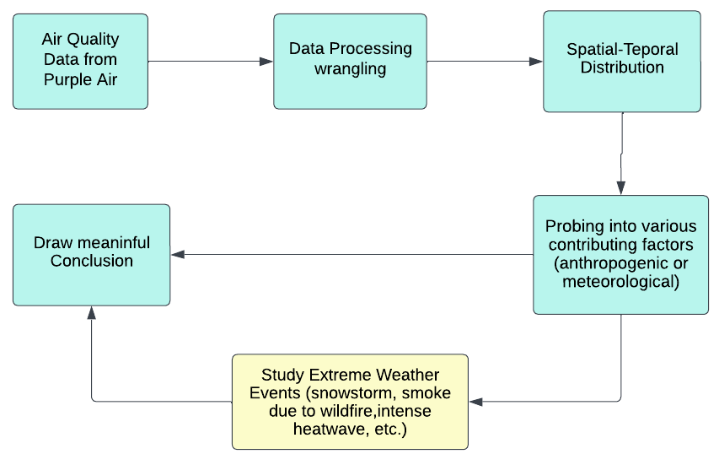
METHODS AND RESULTS
Multi-faceted approach: Data collection, processing, and analysis
Utilization of Python scripts for Extract, Transform, Load (ETL) process
Consideration of various factors influencing air quality dynamics

Slide 6
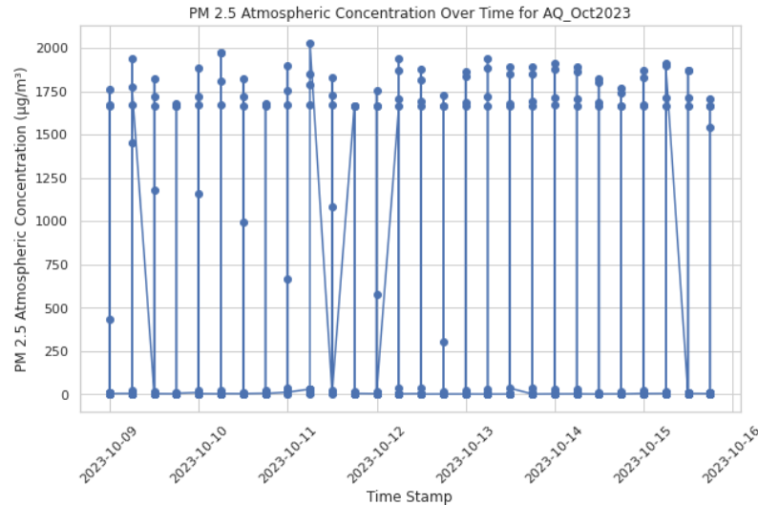
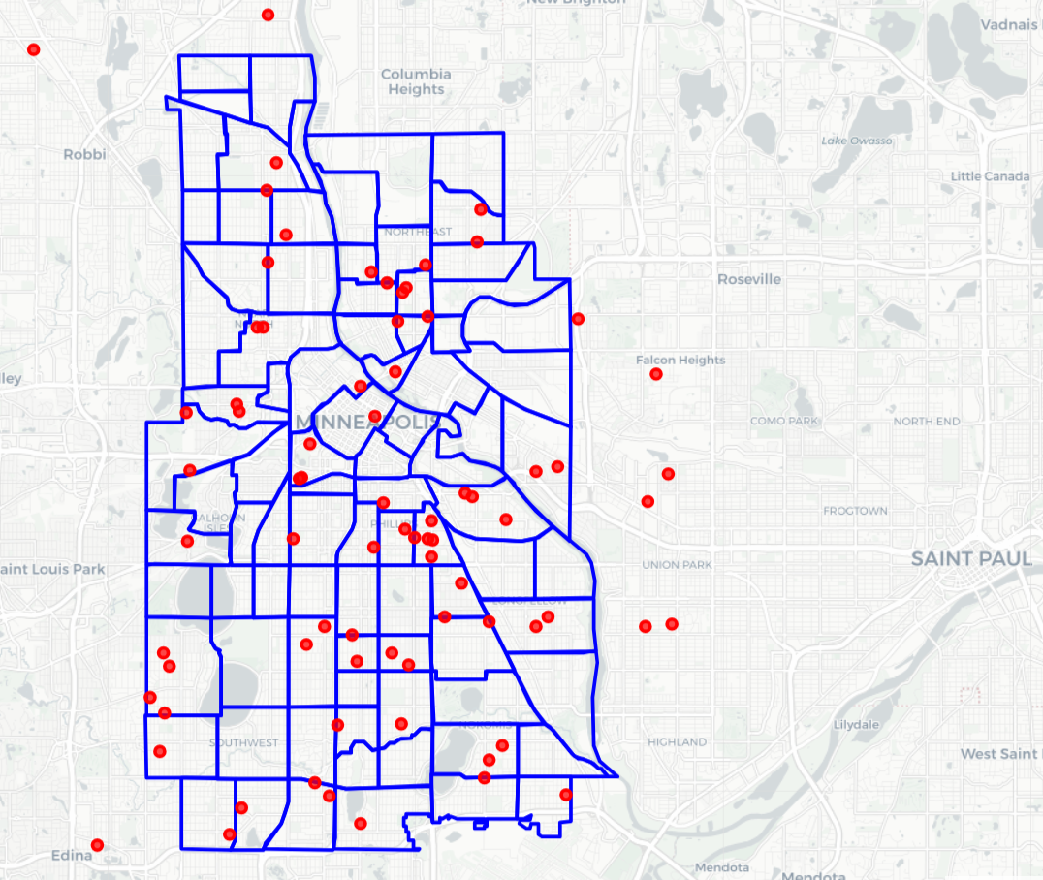
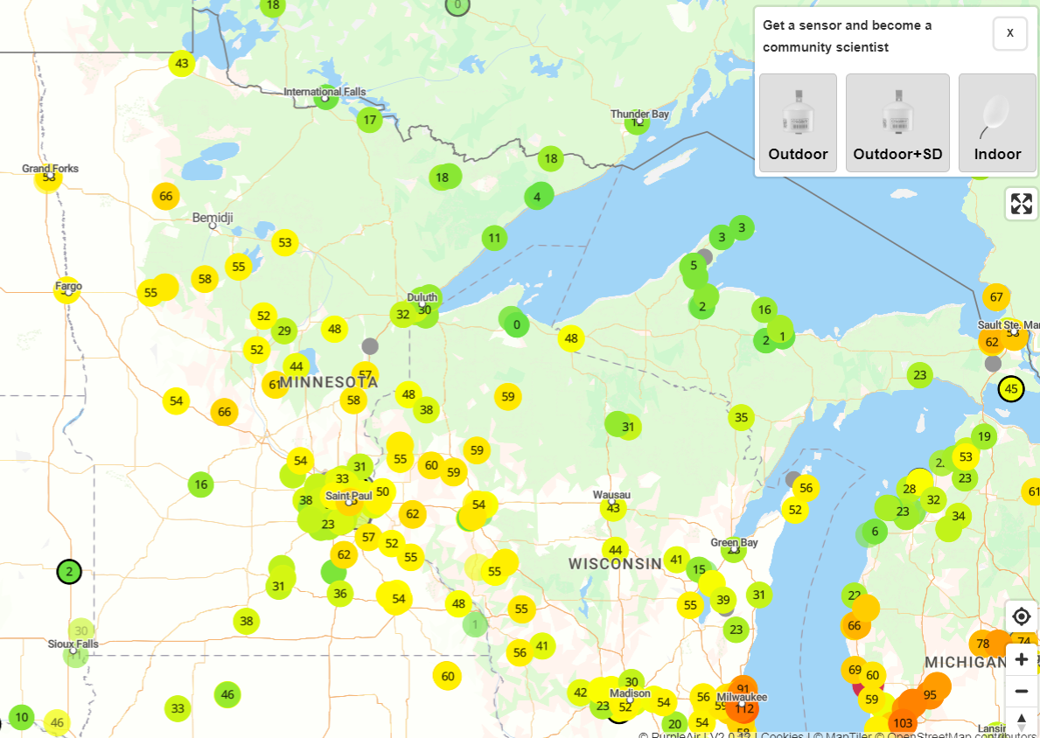
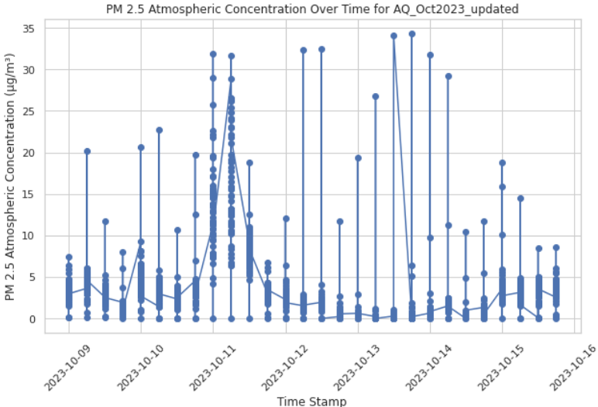
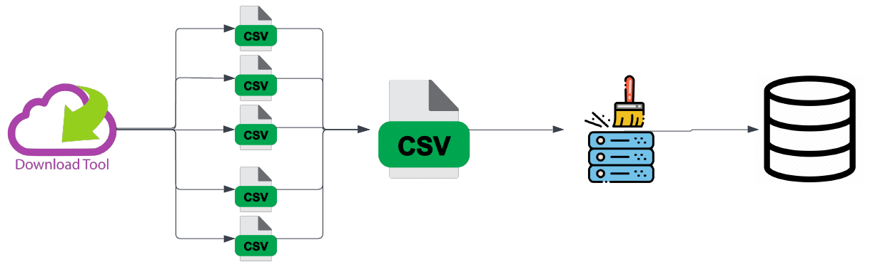
DATA COLLECTION & PROCESSING
Cleaning and wrangling of data to ensure accuracy, consistency, compatibility, and relevance
Use of PurpleAir API for data collection
Importance of community support for effective API calls and navigation
Notes:
The data download tool gives data for individual sensor. Used pandas to do data manipulation and combining csvs on a standard format
All sensors within 5 miles of Minneapolis neighborhood included
Two conditions while cleaning the data.
Average < 500 µg/m³
Highest < 1004 µg/m³ (reported in Tiruppur, India)

Slide 7
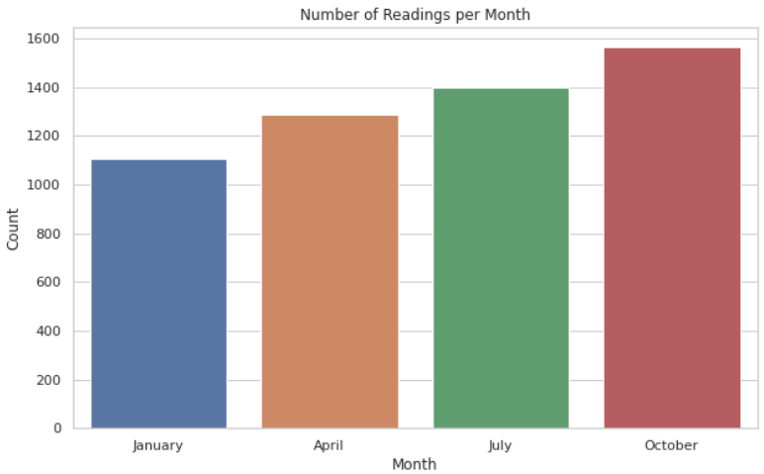
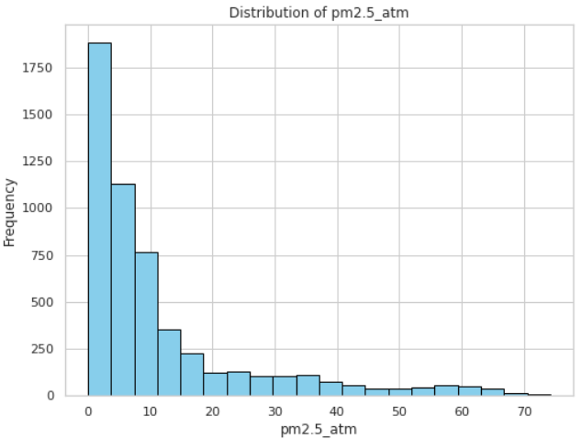
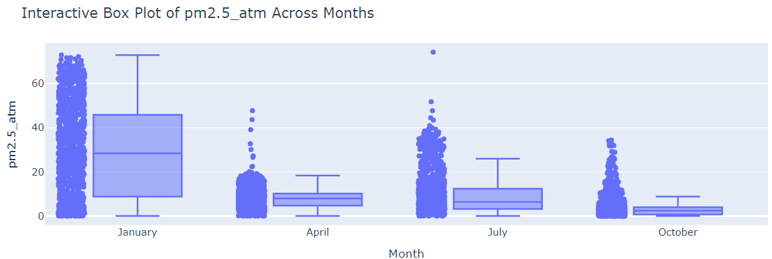
DATA SUMMARY
Spatial-temporal distribution of PM2.5 data
Identification of patterns and trends across different time frames and locations
Initial insights from data exploration
Notes:
Reason for different data points: new sensors added by Purple Air over the time!

Slide 8
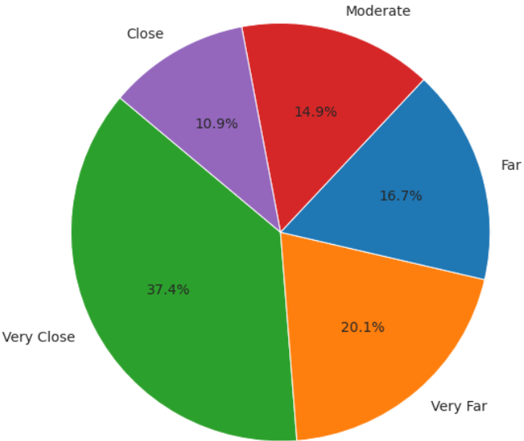
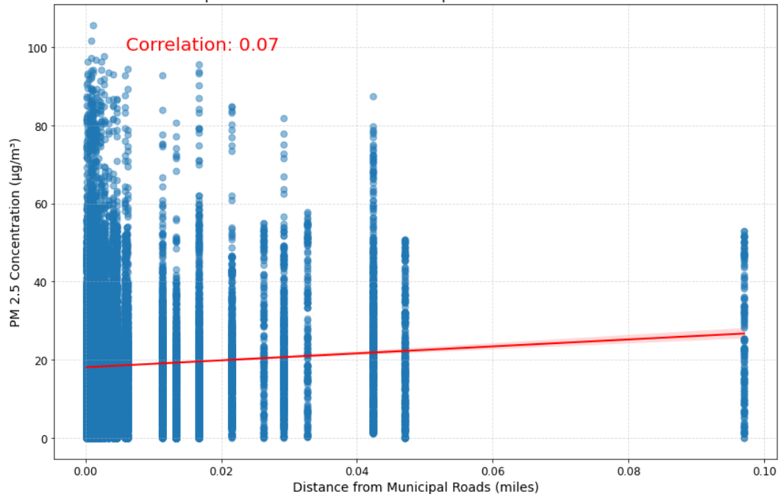
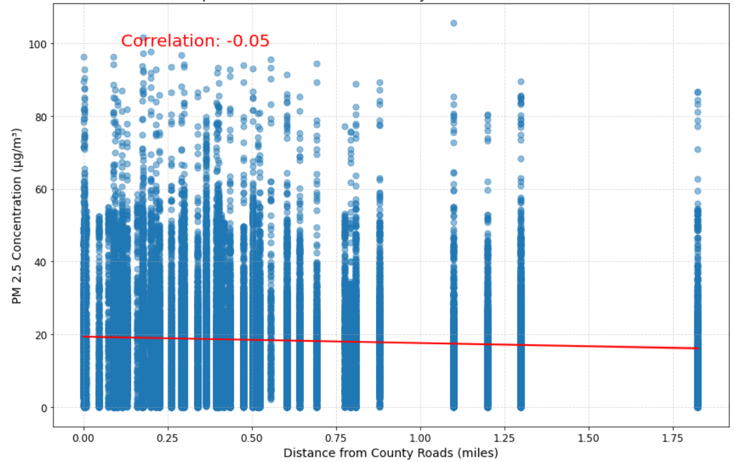
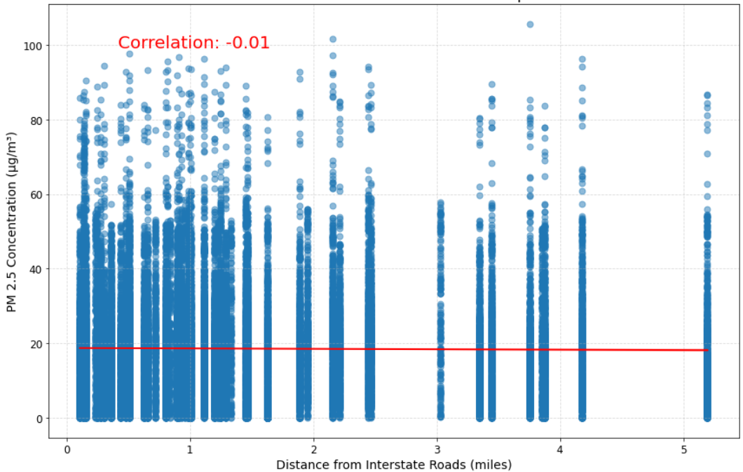
AQ Vs Distance from Roads
Most sensors are in close proximity of road network.
Correlation analysis between PM2.5 values and proximity to roads.
Municipal roads: A weak positive correlation
County roads: A weak negative correlation
Interstate roads: Negligible correlation
Notes:
(0, 0.05]: 'Very Close’ - (0.05, 0.2]: 'Close’ - (0.2, 0.5]: 'Moderate’ - (0.5, 1]: 'Far’ - (1, ∞): 'Very Far’ ---> Distance is in miles

Slide 9
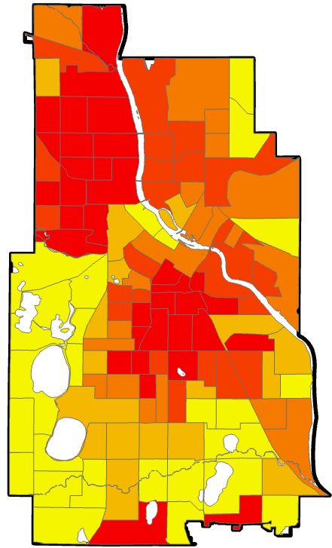
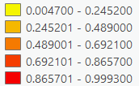
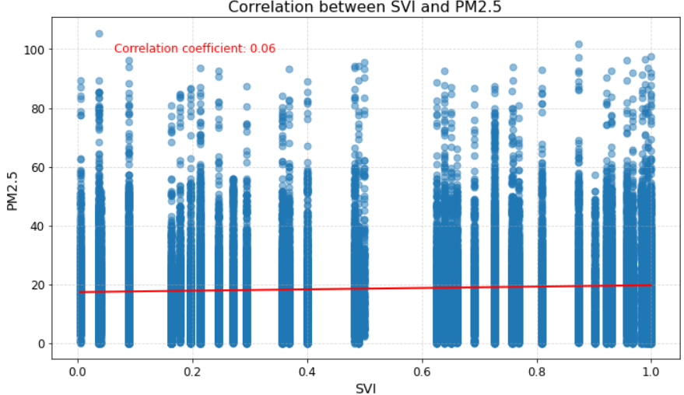
Impact of Social Vulnerability Index
SVI and air quality sensor data are merged based on their intersection to analyze the relationship.
A weak positive correlation between SVI and PM2.5
SVI 2020
Notes:
Understanding the correlation between social vulnerability and PM2.5 concentrations is crucial for identifying disparities, prioritizing public health interventions, informing policy decisions, and engaging communities in environmental advocacy efforts.
While statistically significant, the strength of this correlation is relatively low, implying that other factors beyond social vulnerability may have a more pronounced impact on air quality in Minneapolis.

Slide 10
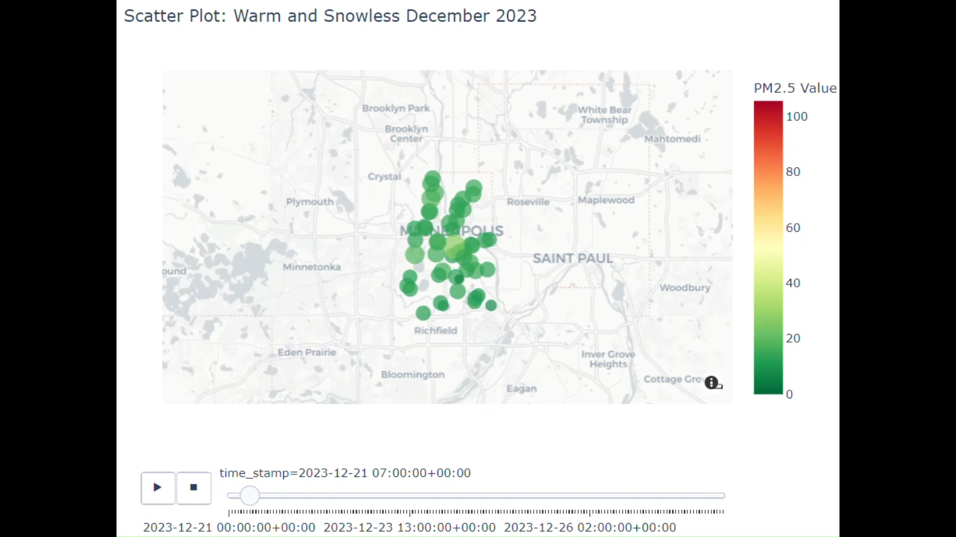
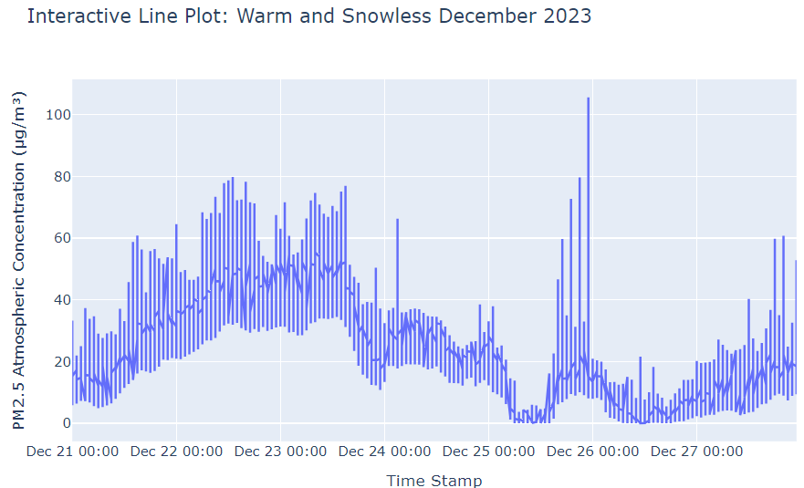
Influence of Anomalous Weather Events
DNR Alerts: https://www.dnr.state.mn.us/climate/journal/index.html
Spring Storm (Again), April 14-17, 2023
Smoke Event of July 14, 2023
Intense Heat Wave, August 21-23, 2023
Welcome Rains Douse Minnesota: September 23-25, 2023
Twin Cities see biggest Halloween snowfall in over 30 years
Warm and Snowless December 2023

Slide 11
CONCLUSION
Proximity to different types of roads and SVI shows varying weak correlations with PM2.5 levels
Emphasis on the significance of meteorological factors
Enhanced understanding of air quality dynamics through visually captivating exploration of temporal trends.
Implications for informed policy decisions and air quality management strategies

Slide 12
REFERENCES
Chen, D., Liu, X., Lang, J., Zhou, Y., Wei, L., Wang, X., & Guo, X. (2017). Estimating the contribution of regional transport to PM2.5 air pollution in a rural area on the North China Plain. Science of the Total Environment, 583, 280-291.
Chen, Z., Chen, D., Zhao, C., Kwan, M. P., Cai, J., Zhuang, Y., ... & Xu, B. (2020). Influence of meteorological conditions on PM2.5 concentrations across China: A review of methodology and mechanism. Environment International, 139, 105558.
Duhanyan, N., & Roustan, Y. (2011). Below-cloud scavenging by rain of atmospheric gases and particulates. Atmospheric Environment, 45(39), 7201-7217.
Feng, X., & Wang, S. (2012). Influence of different weather events on concentrations of particulate matter with different sizes in Lanzhou, China. Journal of Environmental Sciences, 24(4), 665-674.
Guan, W. J., Zheng, X. Y., Chung, K. F., & Zhong, N. S. (2016). Impact of air pollution on the burden of chronic respiratory diseases in China: Time for urgent action. The Lancet, 388(10054), 1939-1951.
Guo, L. C., Zhang, Y., Lin, H., Zeng, W., Liu, T., Xiao, J., ... & Ma, W. (2016). The washout effects of rainfall on atmospheric particulate pollution in two Chinese cities. Environmental Pollution, 215, 195-202.
Guo, X., Shi, J., Ren, D., Ren, J., & Liu, Q. (2017). Correlations between air pollutant emission, logistic services, GDP, and urban population growth from vector autoregressive modeling: A case study of Beijing. Natural Hazards, 87, 885-897.
Jing, Z., Liu, P., Wang, T., Song, H., Lee, J., Xu, T., & Xing, Y. (2020). Effects of meteorological factors and anthropogenic precursors on PM2.5 concentrations in cities in China. Sustainability, 12(9), 3550.
Sun, R., Zhou, Y., Wu, J., & Gong, Z. (2019). Influencing factors of PM2.5 pollution: Disaster points of meteorological factors. International Journal of Environmental Research and Public Health, 16(20), 3891.
Wang, S., Liu, X., Yang, X., Zou, B., & Wang, J. (2018). Spatial variations of PM2.5 in Chinese cities for the joint impacts of human activities and natural conditions: A global and local regression perspective. Journal of Cleaner Production, 203, 143-152.
World Health Organization. (2021, November 15). Ambient (outdoor) air pollution. Retrieved from https://www.who.int/news-room/fact-sheets/detail/ambient-(outdoor)-air-quality-and-health

Slide 13
QUESTIONS?

